Slide 1
A Comparative Study of Chatbots Catered towards Mental Health
Group - 2
[16101298] Mashruk Mohammed Wasik
[18101162] Syeda Rifa Syara
[18101389] Abir Alam Srabon
[18101424] Pranto Dev
[18101689] Sameeha Haque
[19101038] Fariha Rahman
[19101279] Shadman Bin Sharife
[19101640] Asmita Noor
[22166007] Sumaiya Mim
Presented To
Annajiat Alim Rasel
Senior Lecturer
Department of Computer Science and Engineering
BRAC University
Dhaka, Bangladesh

Slide 2
Abstract
Chatbot needs
Comparing models
Accuracy
Population Demographics
Methodology
Limitations
Propose future plan

Slide 3
Introduction
What is a CHATBOT?
Chatbots are chat robots which are programming specialists that can reproduce human discussions through message or voice messages.
How CHATBOTs can Help us?
By building methods that allows Artificial Intelligence agents to replicate human communication using voice commands or text.
What are the significance of CHATBOT?
ChatBots can help to assist people in coping with depression or emotional needs, as well as to provide advice and therapy to those who are suffering.

Slide 4
Related Works
Many researchers worked with chatbots that used various machine learning methods to detect various levels of depression and anxiety
Used machine learning techniques depending on a video and image-based depression identification model.
Evebot, a breakthrough sequence-to-sequence oriented, completely associative interaction approach for the diagnosis of negative emotions and control of distress by favorably recommending answers.
CARO is a chatbot application developed by the researchers that can conduct sympathetic discussions and provide medical advice to those suffering from severe depression.
time-saving model for detecting texts representing self-perceived depressive symptoms using a Long Short-Term Memory (LSTM) based Recurrent Neural Network (RNN)
XiaoIce, which is built on a framework for compassionate computing that allows a machine to perceive human sentiments and states, comprehend user intents, and dynamically respond to user demands.

Slide 5
Methodology Comparison
Name of the bot | Methods
Depra | IDS-SR and QID-SR
Carobot | Medical advice generator and sympathetic dialogue generator
Xiaoice | The user experience layer, Full-duplex mode
Prerona | JSON and UTF-8
Eviebot | Bi-LSTM network and sigmoid activation function

Slide 6
Accuracy Comparison
CARO | BLEU = 0.179
XIAOICE | BLEU = 0.188
PRERONA | SPSS = 13.70% for Bengali , 14% for English, 12.93% for Korean
TESS | PHQ-9 and GAD-7 saw decrease in numbers

Slide 7
Population Demography Comparison
Name of chatbots | Target Audience | Approximate percentage/Numbers
Depra | Young people and older women in low- and middle-income countries (age 15-44) | 800,000
CARO | Teenagers who are suffering from serious depression or chronic clinical depression (tested on Indians) | 90% of those who are affected are unable to access therapists
XiaoIce | Chinese users | N/A
Tess | College students (Based on USA) | The average age of the participants was 23 (22.9) years, with 70% of the participants being female, predominantly Asian 51%, and white 41%
Prerona Evebot | Bengali Users or users knowing Bangla Language School kids and adolescents | 76-86% in low- to middle-income countries do not seek medical attention for their illnesses. N/A

Slide 8
Limitations
Does not collect demographic information.
Does not store the previous information of the user.
The module of one chatbot could not be used on other chatbots.
There might be system errors in the chatbot.
The contents of the chatbot are limited.

Slide 9
Problems
Reasons for mental health disorder vary, depending on geographic location.
Due to globalization, it is almost impossible to categorize people based on location.
Unknown population demographic

Slide 10
Solution
Robust
Smart
Adaptive
Sensitive to user Sentiment

Slide 11
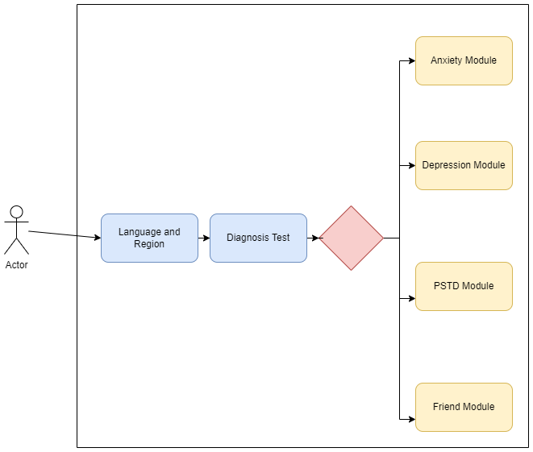
Proposed Chatbot Work Flow

Slide 12
Concluding Remarks
With more research and development it is possible to completely replace cognitive behavioural systems with chatbots.
For better results, the following must be improved:
Reduce discrepancies in communication between different modules
Maintain complete user transparency for accurate detection
Using references that clearly reflect the participant’s emotions
Increased accuracy and usability will allow more participants to resort to chatbots as an entity to confide in when they do not feel too comfortable sharing certain aspects of their sufferings with a therapist.
With further use of Natural Language Processing (NLP) in sentiment analysis, inaccuracies can be brought to a minimum and better precision in the results can be obtained.

